Slide 1


Slide 2
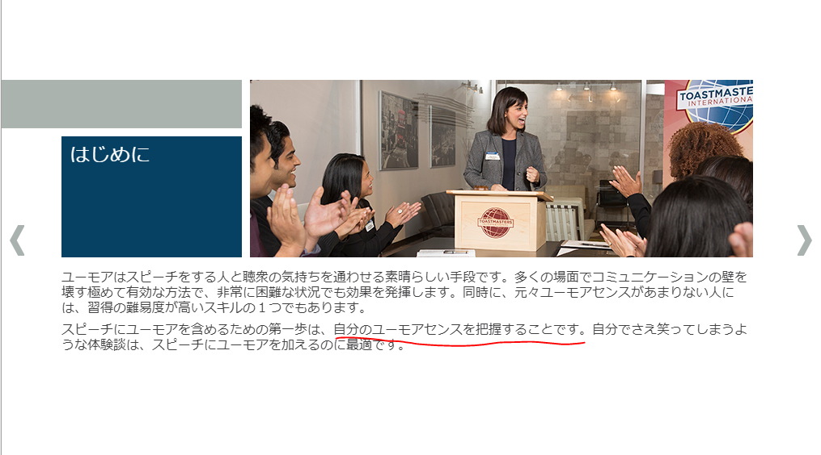

Slide 3
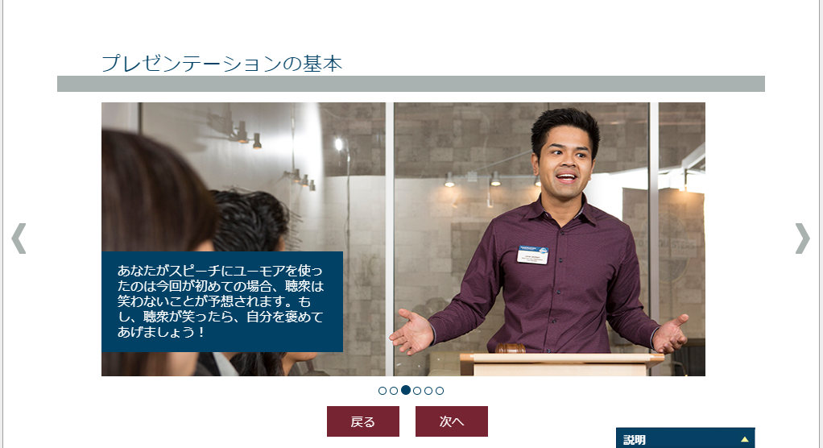

Slide 5
田中のほとんどはトーストマスターズでできている!
Tanaka is Made in Toastmasters

Slide 6
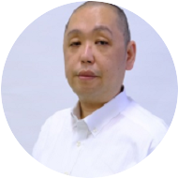
Masayuki Tanaka
2016
Joined Ichikawa TMC
20XX
Joined Tsudanuma TMC
DivD
20XX
Joined Makuhari Bayside TMC
20XX
Joined Chiyoda TMC
20XX
Joined Tokyo Phoenix TMC
Supporting Prospective Clubs
Kashiwa Advanced TMC
Yatsu Advanced TMC
IT TMC
Inzai TMC
千葉論評
20XX
20XX
2017
President, Ichikawa TMC
2020
Area Director, Area 42

Slide 7
Why it happens？

Slide 8
Why not join the club？

Slide 9
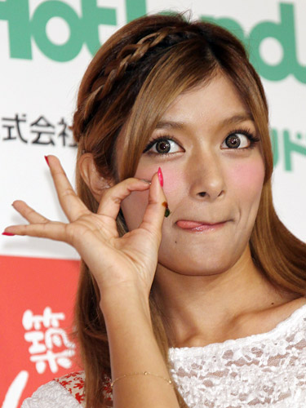
OK！

Slide 10
Could you take a role of VPPR？

Slide 11
OK！

Slide 12
Could you take a role of VPM？

Slide 13
OK！

Slide 14
Could you take a role of VPE？

Slide 15
OK！

Slide 16
Could you take a role of President？

Slide 17
OK！

Slide 18
Could you help District Contest？

Slide 19
OK！

Slide 20
Could you take a role of Area Director？

Slide 21
OK！

Slide 22
Could you take a role of Division Director？

Slide 23
OK！

Slide 24
Division D Director
Masayuki Tanaka

Slide 25
Servant Leadership？

Slide 26
What is it！

Slide 27
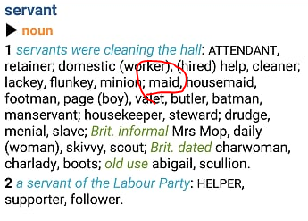
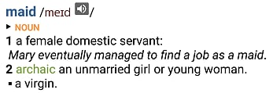

Slide 28
It means

Slide 29
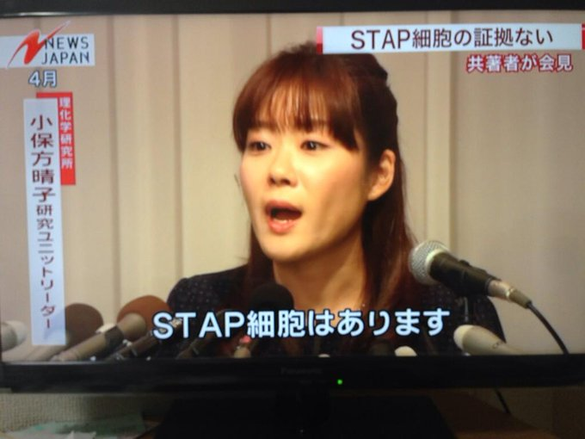
We have maids in toastmasters！

Slide 30
Maid in Toastmasters

Slide 31
Imagine

Slide 32
Why not join the club？

Slide 33

Yes, my lord！

Slide 34
Could you take a role of VPPR？

Slide 35
Yes, my lord！

Slide 36
Could you take a role of VPM？

Slide 37
Yes, my lord！

Slide 38
Could you take a role of VPE？

Slide 39
Yes, my lord！

Slide 40
Could you take a role of President？

Slide 41
Yes, my lord！

Slide 42
Could you help district contest？

Slide 43
Yes, my lord！

Slide 44
Could you take a role of Area Director？

Slide 45
Yes, my lord！

Slide 46
Could you take a role of Division Director？

Slide 47
Yes, my lord！

Slide 48
The answer is in my mind!
I know servant leadership

Slide 49

東にPathwaysに戸惑うクラブあれば
行ってワークショップをおこない
西に論評に悩むクラブあれば
行ってワークショップをおこない
南にzoomアカウントが足りないクラブあれば
行ってzoomのホストをし
北に女装でお越しくださいというクラブあれば
行って女装で総合論評し
みんなにデクノボウとよばれ
ほめられもせず くにもされず そういうディレクターに わたしはなりたい

Slide 50
そういうディレクターに わたしはなりたい

Slide 51
ので

Slide 52


